Slide 1
CHAPTER 5:STORAGE

Slide 2
Memory
While performing a processing operation, the CPU needs a place to temporarily hold instructions to be executed and data to be used with those instructions.
Memory, which is composed of one or more chips on the motherboard, holds data and instructions while they are being processed by the CPU.
Two basic types of memory are volatile and non-volatile. The contents of volatile memory, such as RAM, are lost (erased) when the power to the computer is turned off.
The contents of non-volatile memory, however, are not lost when power is removed from the computer.

Slide 3
STORAGE
also called secondary storage, auxiliary storage, or mass storage, holds items such as data, instructions, and information for future use.
non-volatile, which means that items in storage are retained even when power is removed from the computer.
Storage devices can function as sources of input and output.

Slide 4
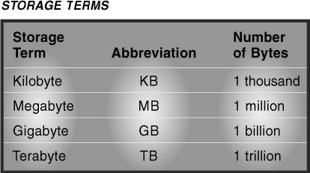
Storage Terms

Slide 5
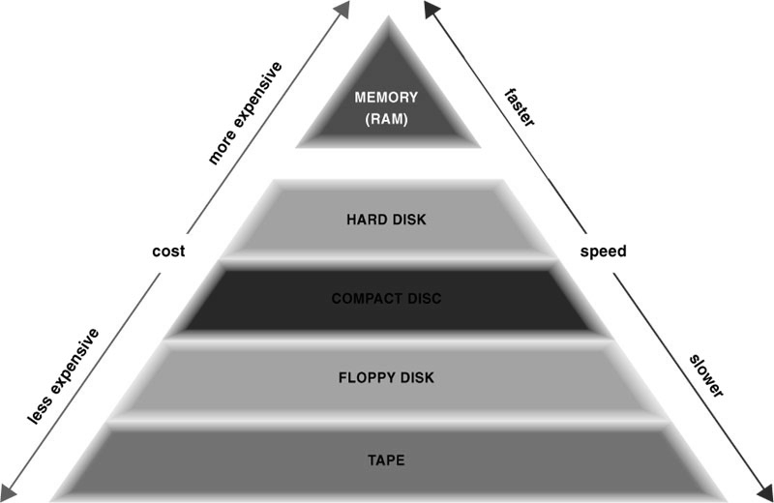

Slide 6
Floppy disk

Slide 7
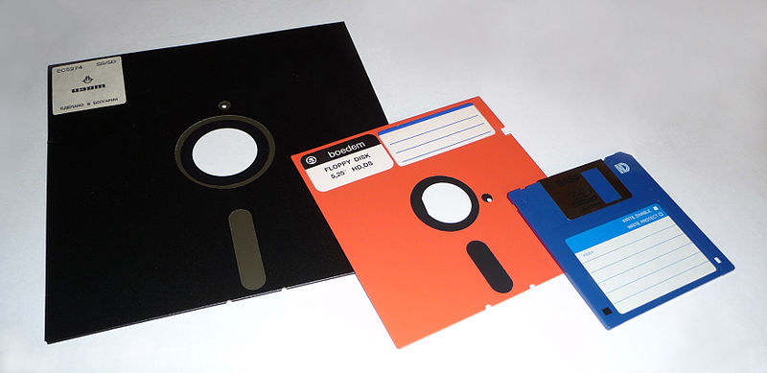
Floppy Disks
A floppy disk, or diskette, is a portable, inexpensive storage medium that consists of a thin, circular, flexible plastic disk with a magnetic coating enclosed in a square-shaped plastic shell.
1970s IBM
8 inches wide 79.7KB
5.25-inches wide. 500KB
3.5-inches wide 1.44MB

Slide 8
Characteristics of Magnetic Media
A floppy disk is a type of magnetic media, which means it uses magnetic patterns to store items such as data, instructions, and information on the disk’s surface.
read/write storage media
A track is a narrow recording band that forms a full circle on the surface of the disk.
small arcs in tracks is called sectors, capable of holding 512 bytes of data.
80 tracks and 18 sectors per track.

Slide 9
Characteristics of Magnetic Media
A sector that cannot be used due to a physical flaw on the disk is called a badsector.
A cluster is the smallest unit of space used to store data.
Disk density is computed by multiplying together the number of sides on the disk, the number of tracks on the disk, the number of sectors per track, and the number of bytes in a sector.
2 (sides) x 80 (tracks) x 18 (sectors per track) x 512 (bytes per sector) = 1,474,560 bytes, or approximately 1.44 MB.

Slide 10
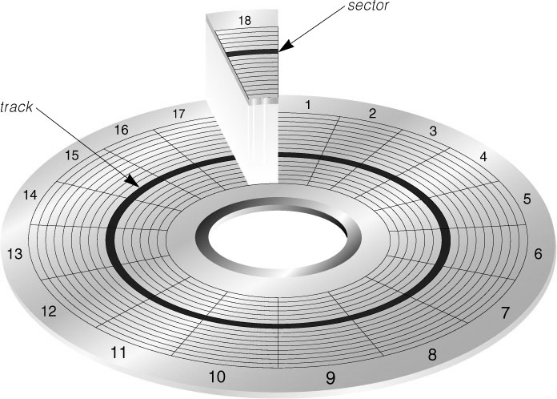

Slide 11
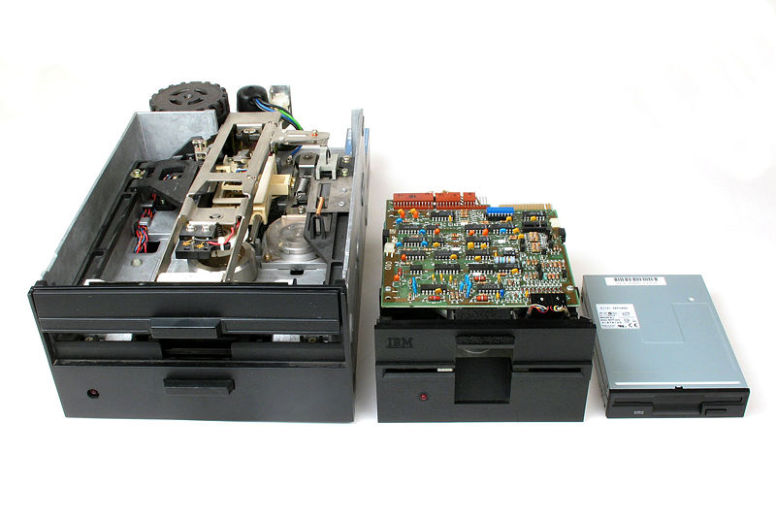
Floppy Disk Drives
a floppy disk drive (FDD) is a device that can read from and write on a floppy disk.
drive usually is designated drive A; if the computer has two floppy disk drives, the second one usually is designated drive B.

Slide 12
File System
File Allocation Table (FAT)
New Technology File System (NTFS)
The formatting process erases the file location information and redefines the file allocation table for these items.

Slide 13
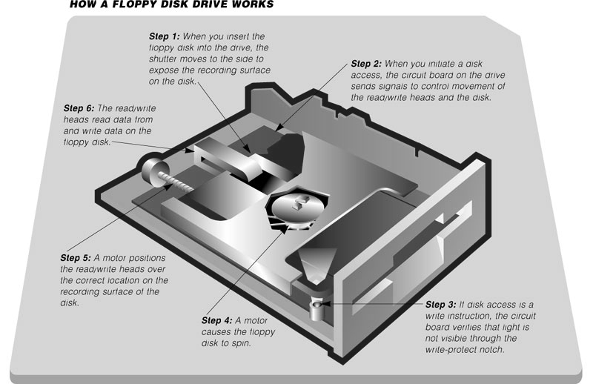

Slide 14
How Do You Care for a Floppy Disk?
avoid exposing it to heat, cold, magnetic fields, and contaminants such as dust, smoke, or salt air.
Exposure to any of these elements could damage or destroy the data, instructions, and information stored on the floppy disk.

Slide 15
High-Capacity Floppy Disks
SuperDisk - developed by Jmation that reads from and writes on a 120 MB
High-Capacity FD – Sony Electronics Inc. 200 MB
Zip® drive - developed by Iomega Corporation, 250 MB

Slide 16
HARD DISK

Slide 17
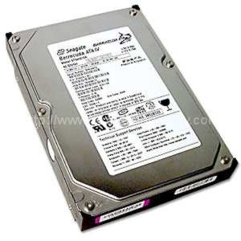
HARD DISKS
consists of several inflexible, circular disks, called platters, on which items are stored electronically.
A platter in a hard disk is made of aluminum, glass, or ceramic and is coated with a material that allows items to be magnetically recorded on its surface.

Slide 18
two formatting steps:
low-level format, organizes both sides of each platter into tracks and sectors to define where items will be stored on the disk.
hard disk can be divided into separate areas called partitions
a high-level format command is issued through the operating system to define, among other items, the file allocation table (FAT) for each partition.
Drive C, Drive D

Slide 19
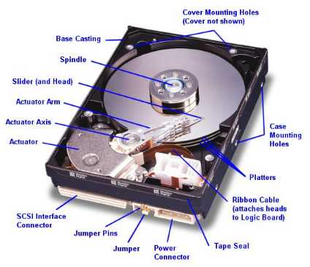

Slide 20
How a Hard Disk Works?
Most hard disks have multiple platters stacked on top of one another and each platter has two read/write heads, one for each side.
The hard disk has arms that move the read/write heads to the proper location on the platter.
Because of the stacked arrangement of the platters, the location of the read-write head often is referred to by it cylinder instead of its track.

Slide 21
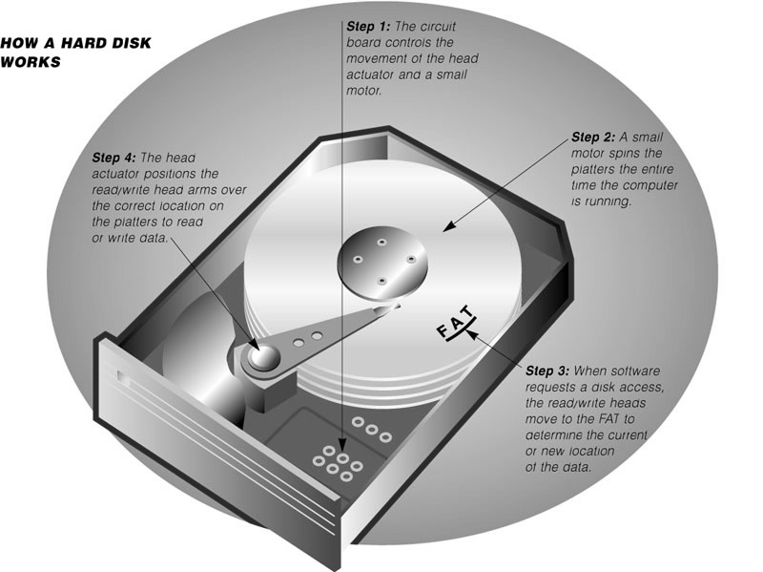

Slide 22
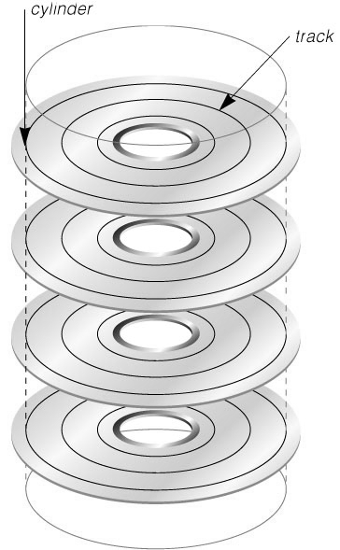
How a Hard Disk Works?
A cylinder is the location of a single track through all platters.
if a hard disk has four platters (eight sides), each with 1,000 tracks, then it will have 1,000 cylinders with each cylinder consisting of eight tracks (two for each platter). While your computer is running, the platters in the hard disk rotate at a high rate of speed, usually 5,400 to 7,200 revolutions per minute.
The platters continue spinning until power is removed from the computer.

Slide 23
How a Hard Disk Works?
The spinning motion creates a cushion of air between the platter and its read/write head so the read/write head floats above the platter instead of making direct contact with the platter surface.
The distance between the read/write head and the platter is approximately two millionths of an inch.
A head crash occurs when a read/write head touches the surface of a platter, usually resulting in a loss of data or sometimes loss of the entire drive.
defragmenting or scanning the disk for errors.

Slide 24
Compact disc

Slide 25
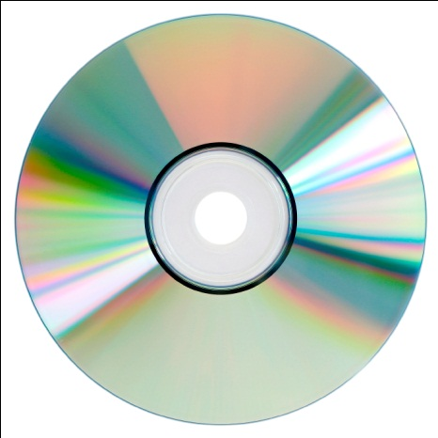
COMPACT DISC
a flat, round, portable, metal storage medium that usually is 4.75 inches in diameter and less than one-twentieth of an inch thick.
Compact disks store items such as data, instructions, and information by using microscopic pits (indentations) and land (flat areas) that are in the middle layer of the disc.
A high-powered laser light creates the pits.
A low-powered laser light reads items from the compact disc by reflecting light through the bottom of the disc, which usually is either solid gold or silver in color.

Slide 26

COMPACT DISC
The reflected light is converted into a series of bits that the computer can process.
Land causes light to reflect, which is read as binary digit 1. Pits absorb the light; this absence of light is read as binary digit 0.
A compact disc stores items in a single track that spirals from the center of the disc to the edge of the disc.

Slide 27
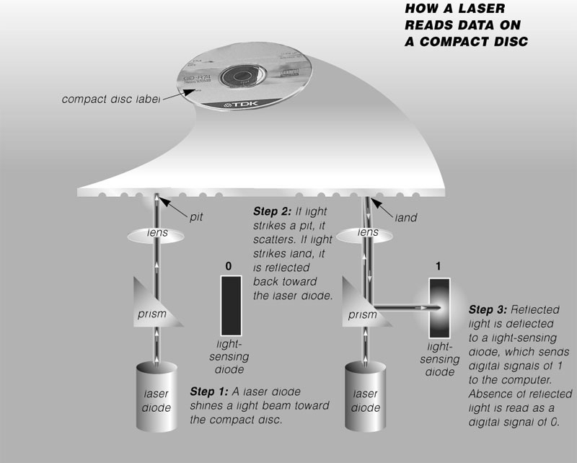

Slide 28
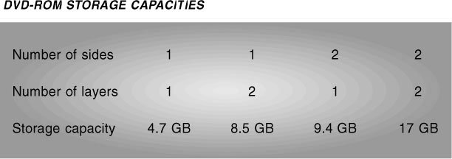
Types of Compact Disc
CD-ROM (Compact Disc-Read Only Memory)
CD-R (Compact Disc-Recordable)
CD-RW (Compact Disc-Rewriteable )
DVD-ROM (Digital Video Disc-Read Only Memory)
DVD-R (Digital Video Disc-Recordable)
DVD-RW (Digital Video Disc-Rewriteable)

Slide 29
TAPES

Slide 30
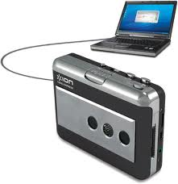
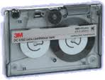
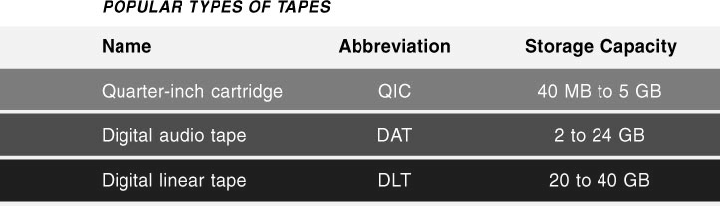
Tape
a magnetically coated ribbon of plastic capable of storing large amounts of data and information at a low cost.
sequential access, which refers to reading or writing data consecutively.
long-term storage and backup.

Slide 31
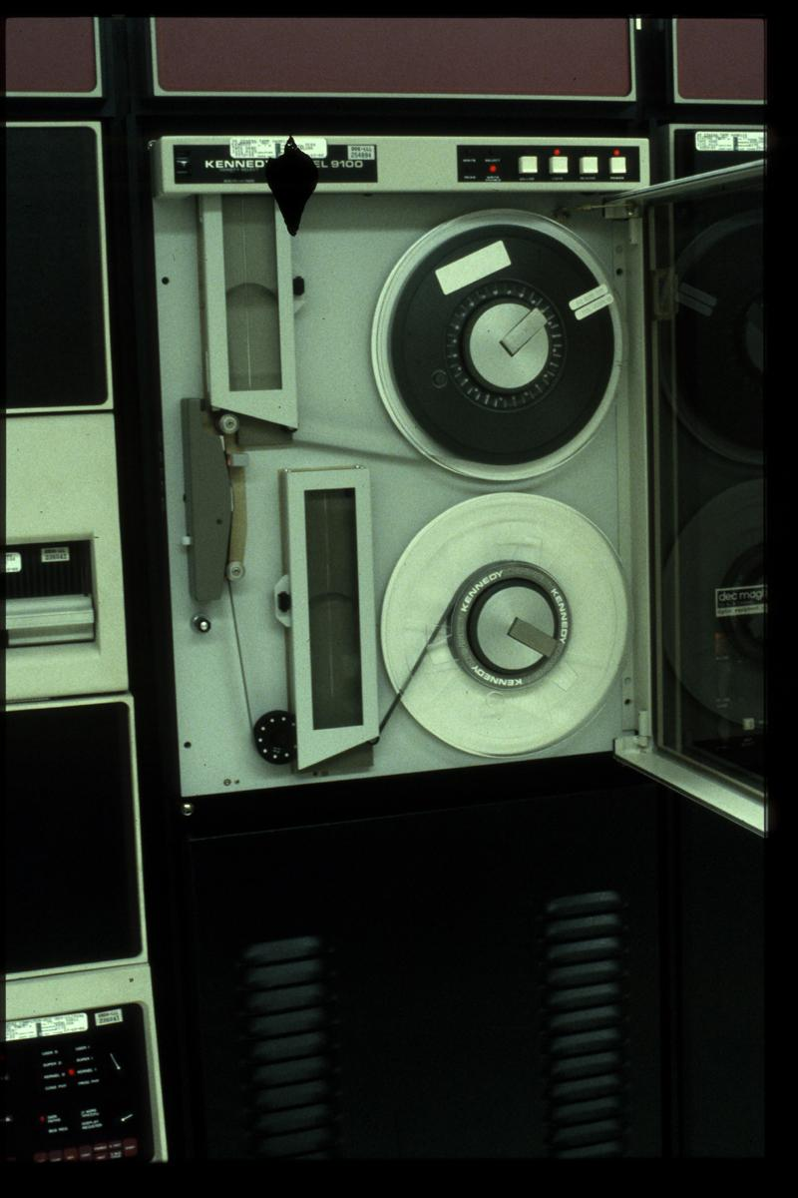

Slide 32
PC Cards

Slide 33
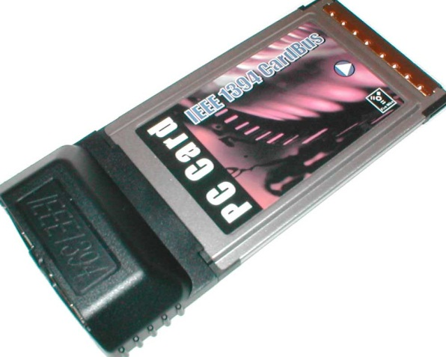
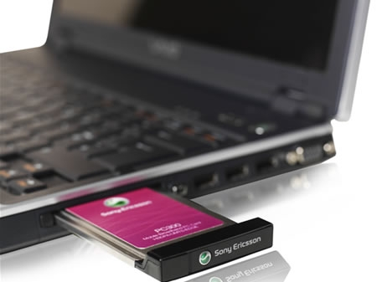
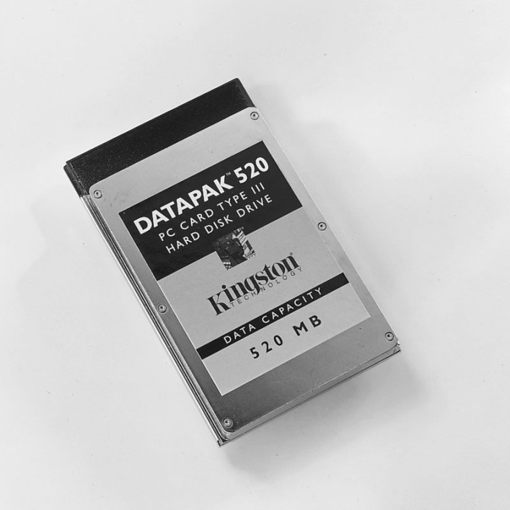
PC Card
a thin, credit card-sized device that fits into a PC Card expansion slot on a laptop or other personal computer.
Type I, Type II, and Type III.

Slide 34
Smart Cards

Slide 35
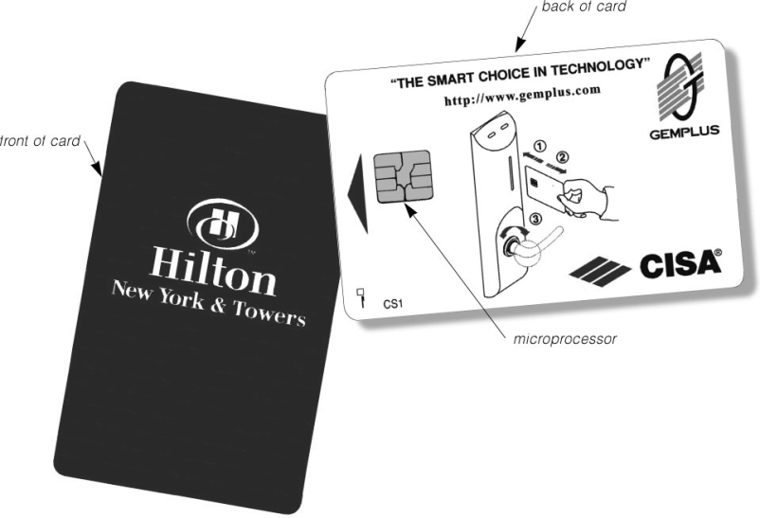
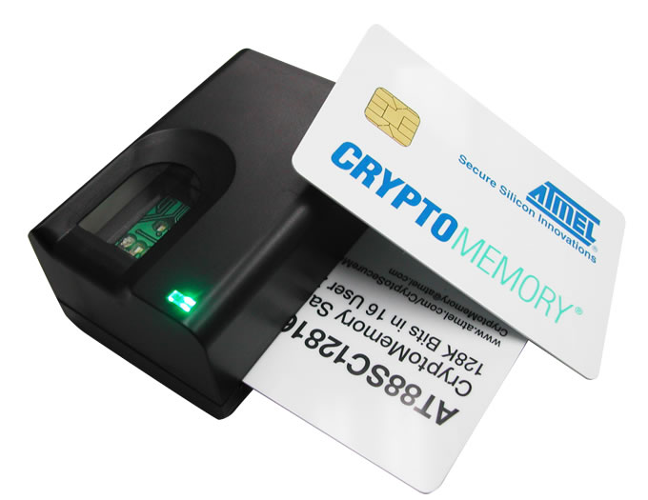
Smart Card
which is similar in size to a credit card or ATM card, stores
data on a thin microprocessor embedded in the card
An intelligent smart card contains a CPU and has input, process, output, and storage capabilities.
a memory card has only storage capabilities.

Slide 36
Microfilm and Microfiche

Slide 37
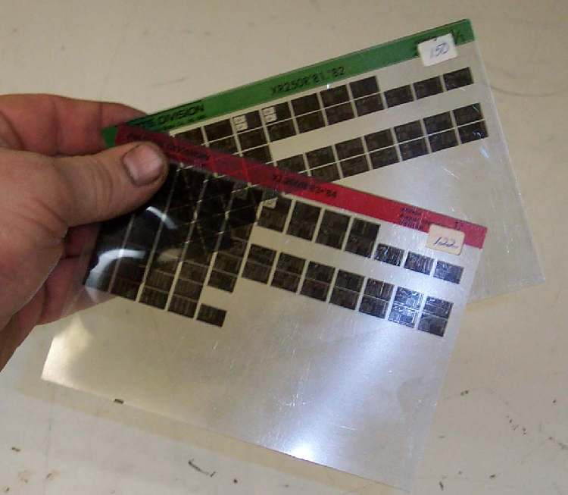

Microfilm and Microfiche
Microfilm and microfiche are used to store microscopic images of documents on roll or sheet film.
Microfilm uses a 100- to 215-foot roll of film.
Microfiche uses a small sheet of film, usually about four inches by six inches.

